Slide 1
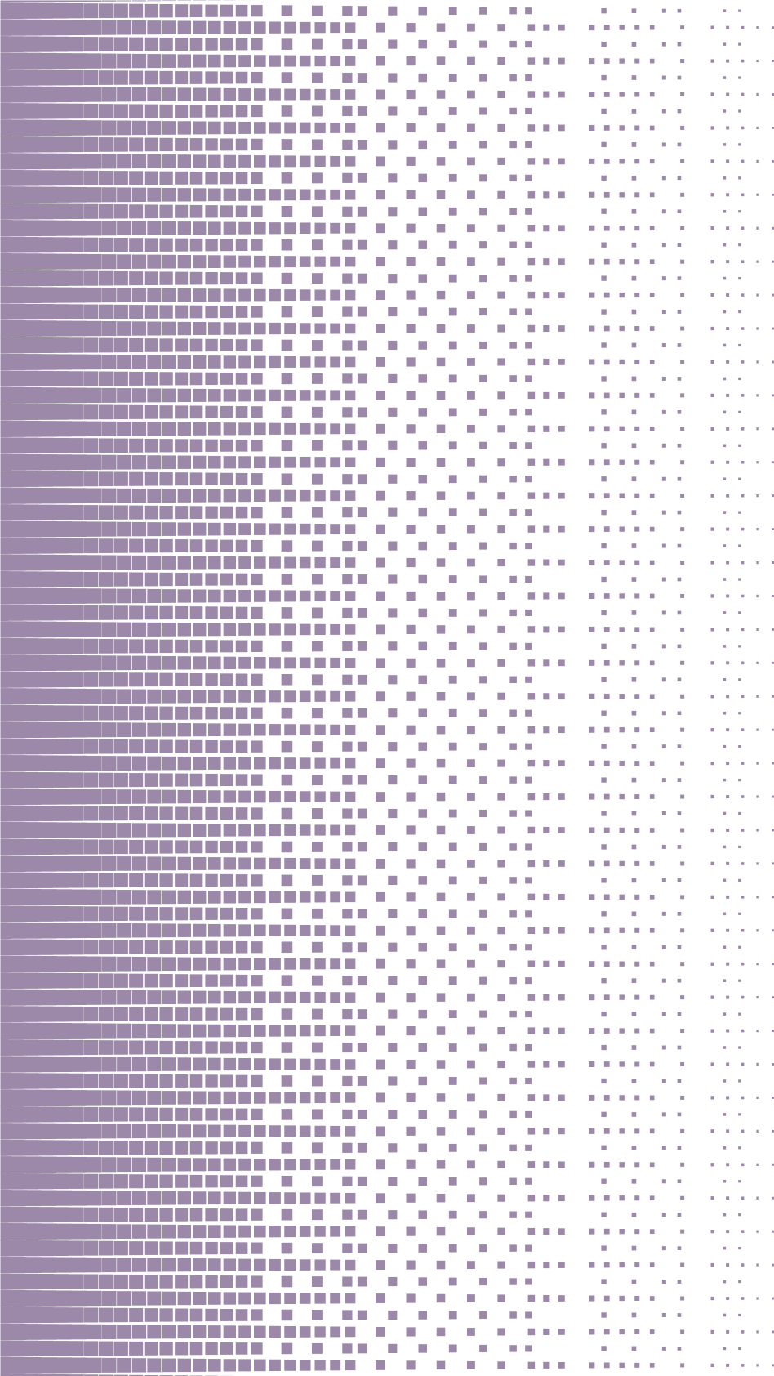
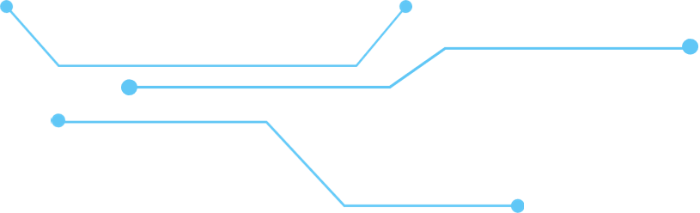
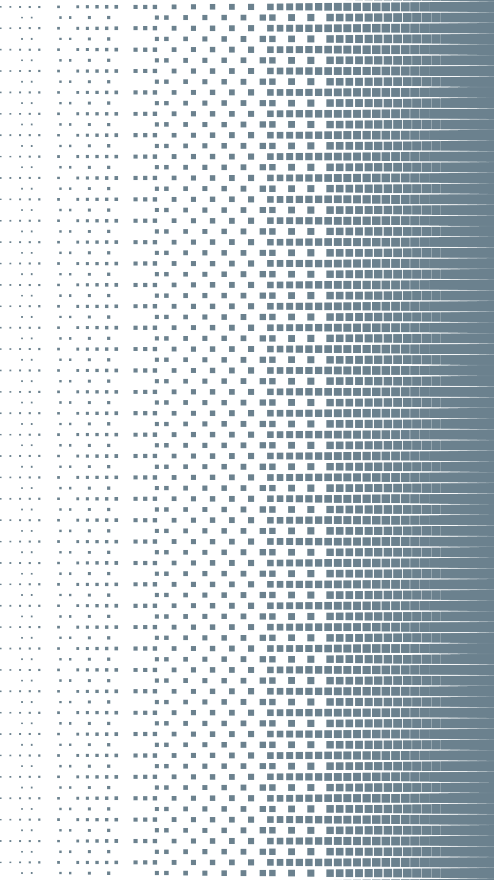
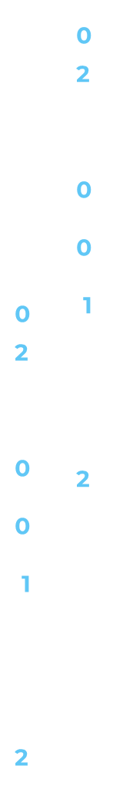


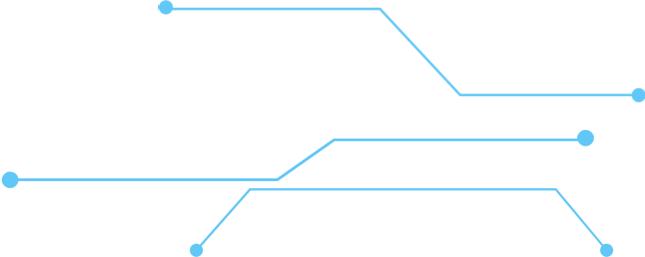
SMART RAG Video
Transcript Based
Elhai Swisa

Slide 2
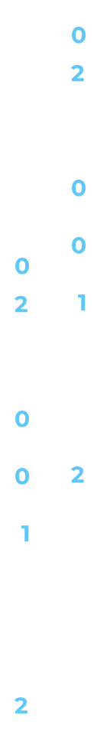
TABLE OF CONTENTS
1.
Introduction & Demo
1.
2.
Creation Process
3.
How It Works
4.
Challenges and Solutions

Slide 3

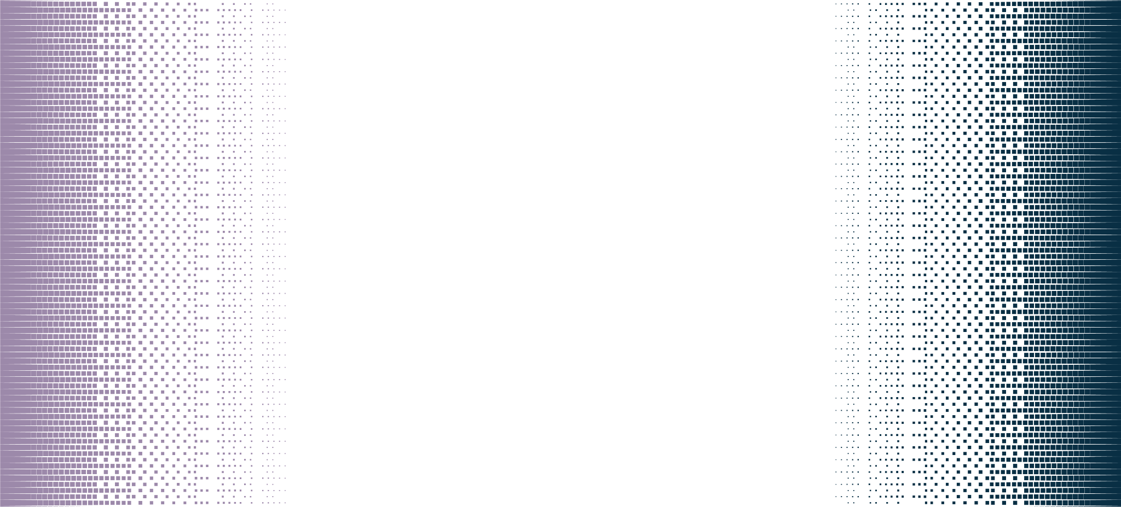






Introduction - Video Transcript RAG System
Description: A RAG-based bot utilizing transcripts from:
A YouTube playlist of MIT lectures on deep learning.
An additional 25-hour YouTube course on pytorch for deep learning.
Objective: To generate answers based on the relevant video
segment for a given question.
Additionally, the bot provides the timestamp of the
lecture section where the answer can be found.
Telegram BOT
Streamlit Web

Slide 4
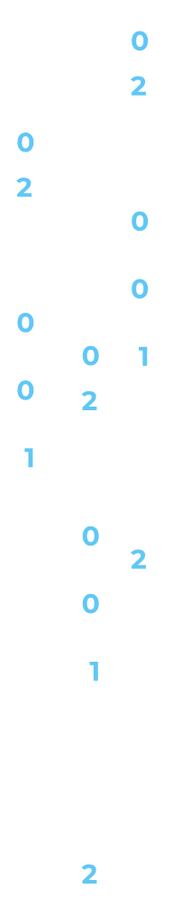

Creation Process
Transcript Extraction
Chunking Transcripts
Contextualization
Vector Database Setup
Application Development
Telegram Bot Creation
Download transcripts for each video.
Save the data as a JSON file, including the video link and transcript
Split transcripts into 5-minute chunks for efficient processing.
For each chunk, create context by:
Sending the full transcript and the specific chunk to an LLM.
Associating the chunk with the overall content of the lecture.
Upload data to Pinecone to create a vector database.
Generate embeddings directly for the specified transcript chunks.
Build a Streamlit application to host the bot interface.
Wrap the process with FastAPI.
Deploy to Render and integrate with Telegram to create the bot.

Slide 5





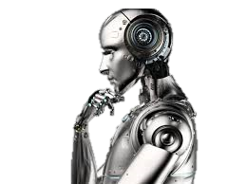

How It Works
The matching transcripts are retrieved
Adds the timestamp to the YouTube link, starting the video at the exact minute.
Text Retrieval
Video Link
Vector Search
User Question
A semantic search finds relevant transcript chunks
LLM Processing
The user sends a question, which is then embedded for processing
The Mistral LLM:
Summarizes how each video addresses the question.
Scores relevance for each chunk.
Pinpoints the most relevant timestamp using metadata.

Slide 6






Challenges and Solutions
Determining Chunk Size
Creating Context
Handling Irrelevant Questions
Tested chunk divisions of 1 minute, 2 minutes, and 5 minutes.
Balancing the need for broad context and focused answers.
Solution: Settled on 5-minute chunks for optimal performance
.
Provided the previous chunk and the current chunk to the LLM to generate context based on the prior chunk.
Final approach: Sent the entire document along with the current chunk to the LLM.
Restricted the bot to use only the top-matched chunks as the basis for answers.
Implemented a scoring mechanism to evaluate how well each chunk addresses the question.
Answers are displayed only if they meet a minimum score threshold, ensuring relevance and accuracy.

Slide 7
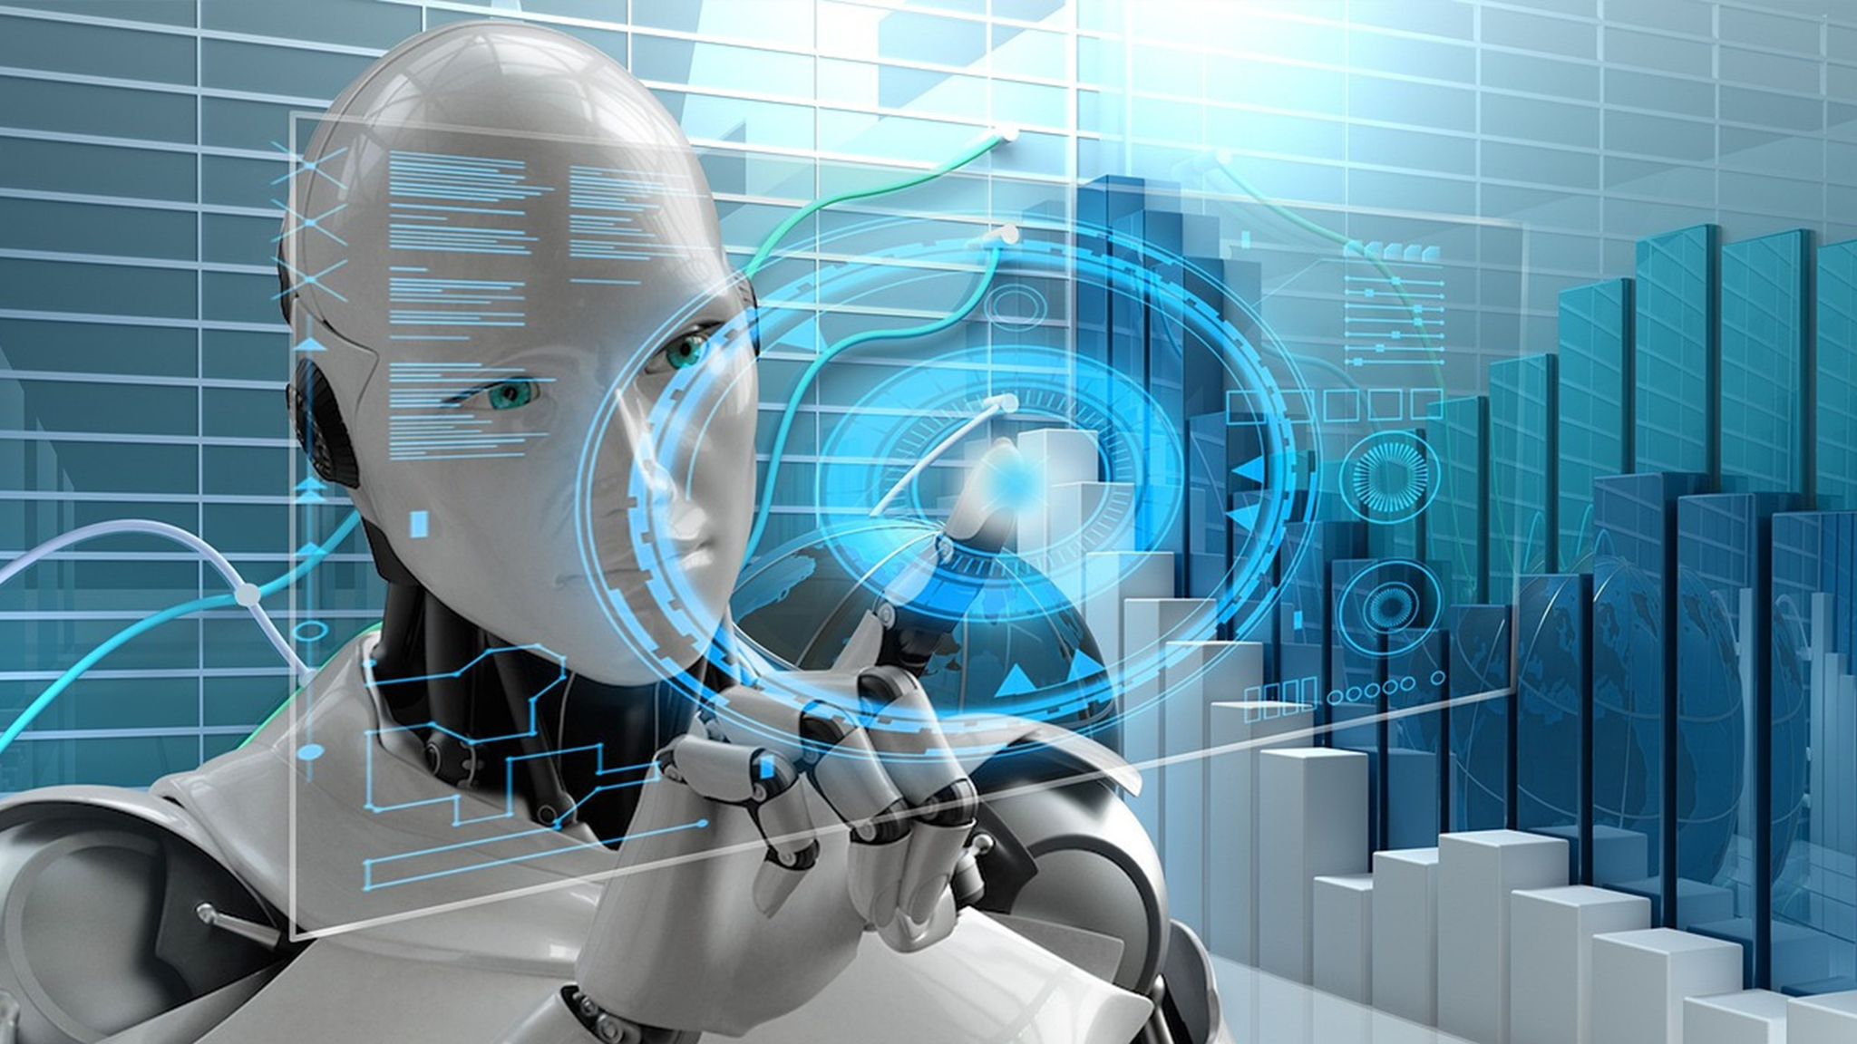
Thank you

